Slide 1

Chapter 2 Primitive Data Types and Operations
Notes:
Operation=operator + operand

Slide 2
Objectives
To write C++ programs to perform simple calculations (§2.2).
To read input from the keyboard using the cin object (§2.3).
To simplify programming by omitting the std:: prefix (§2.4).
To use identifiers to name variables, constants, functions, and classes (§2.5).
To use variables to store data (§§2.6-2.7).
To program with assignment statements and assignment expressions (§2.7).
To use constants to store permanent data (§2.8).
To declare variables using numeric data types (§2.9).
To use operators to write numeric expressions (§2.9).
To convert numbers to a different type using casting (§2.10).
To represent character using the char type (§2.11).
To become familiar with C++ documentation, programming style, and naming conventions (§2.13).
To distinguish syntax errors, runtime errors, and logic errors (§2.14).
To debug logic errors (§2.15).

Slide 3
Introducing Programming with an Example
Listing 2.1 Computing the Area of a Circle
This program computes the area of the circle.

Slide 4
Trace a Program Execution
animation
allocate memory for radius
#include <iostream>
int main() {
double radius;
double area;
// Step 1: Read in radius
radius = 20;
// Step 2: Compute area
area = radius * radius * 3.14159;
// Step 3: Display the area
std::cout << "The area is ";
std::cout << area << std::endl;
}
radius
no value
Notes:
Question: how many memory units will the area variable occupy?
Std is a namespace. Cout is an object belonging this namespace just like a file in the folder.
<< is an operator.
Operation is composed of operator and operand.

Slide 5
Trace a Program Execution
animation
#include <iostream>
int main() {
double radius;
double area;
// Step 1: Read in radius
radius = 20;
// Step 2: Compute area
area = radius * radius * 3.14159;
// Step 3: Display the area
std::cout << "The area is ";
std::cout << area << std::endl;
}
memory
radius
no value
area
no value
allocate memory for area

Slide 6
Trace a Program Execution
animation
assign 20 to radius
#include <iostream>
int main() {
double radius;
double area;
// Step 1: Read in radius
radius = 20;
// Step 2: Compute area
area = radius * radius * 3.14159;
// Step 3: Display the area
std::cout << "The area is ";
std::cout << area << std::endl;
}
radius
20
area
no value

Slide 7
Trace a Program Execution
animation
#include <iostream>
int main() {
double radius;
double area;
// Step 1: Read in radius
radius = 20;
// Step 2: Compute area
area = radius * radius * 3.14159;
// Step 3: Display the area
std::cout << "The area is ";
std::cout << area << std::endl;
}
memory
radius
20
area
1256.636
compute area and assign it to variable area

Slide 8
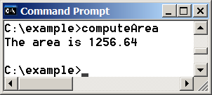
Trace a Program Execution
animation
#include <iostream>
int main() {
double radius;
double area;
// Step 1: Read in radius
radius = 20;
// Step 2: Compute area
area = radius * radius * 3.14159;
// Step 3: Display the area
std::cout << "The area is ";
std::cout << area << std::endl;
}
memory
radius
20
area
1256.636
print a message to the console

Slide 9
Reading Input from the Keyboard
You can use the std::cin object to read input from the keyboard.

Slide 10
Omitting the std:: Prefix
You have noticed that std::cout, std::endl, and std::cin all start with std::. So what is std? std means the standard namespace. C++ divides the world into “namespaces” to resolve potential naming conflicts. std::cout means that cout belongs to the standard namespace. It is tedious to type std:: repeatedly. There is one simple solution to eliminate the std:: prefix.
The first solution is to add the statement:
using namespace std;

Slide 11
Identifiers
An identifier is a sequence of characters that consists of letters, digits, and underscores (_).
An identifier must start with a letter or an underscore. It cannot start with a digit.
An identifier cannot be a reserved word. (See Appendix A, “C++ Keywords,” for a list of reserved words.)
An identifier can be of any length, but your C++ compiler may impose some restriction. Use identifiers of 31 characters or fewer to ensure portability.

Slide 12
Legal or illegal identifiers:
Abc define 2x double student
m+y a# b-4 _1 While
int let x%y name do
π wtm Ctrl switch include
Notes:
define double switch include are the keywords or reserved words.
While is not a keyword but while is a keyword because C++ programming language is case sensitive.

Slide 13
Variables
// Compute the first area
radius = 1.0;
area = radius * radius * 3.14159;
std::cout << area;
// Compute the second area
radius = 2.0;
area = radius * radius * 3.14159;
std::cout << area;

Slide 14
Declaring Variables
int x; // Declare x to be an
// integer variable;
double radius; // Declare radius to
// be a double variable;
char a; // Declare a to be a
// character variable;

Slide 15
Some Important Concepts
x = 1;
A program is composed of several statements.
A statement is composed of an expression and “;” .
An expression is composed of several operator and several operands.
For example,
x=1; is a statement.
x=1 is an expression.
x is a variable, one operand
1 is a literal, the other operand
= is an operator
Notes:
Literal constant.

Slide 16
Assignment Statements
x = 1; // Assign 1 to x;
radius = 1.0; // Assign 1.0 to radius;
a = 'A'; // Assign 'A' to a;

Slide 17
Declaring and Initializing in One Step
int x = 1;
double d = 1.4;

Slide 18
Named Constants
const datatype CONSTANTNAME = VALUE;
const double PI = 3.14159;
const int SIZE = 3;

Slide 19
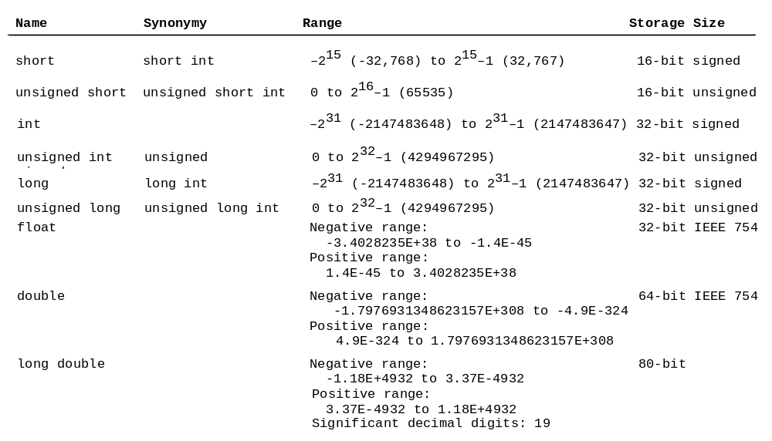
Numerical Data Types

Slide 20
sizeof Function
You can use the sizeof function to find the size of a type. For example, the following statement displays the size of int, long, and double on your machine.
cout << sizeof(int) << " " << sizeof(long) << " " << sizeof(double);

Slide 21
Synonymous Types
short int is synonymous to short. unsigned short int is synonymous to unsigned short. unsigned int is synonymous to unsigned. long int is synonymous to long. unsigned long int is synonymous to unsigned long. For example,
short int i = 2;
is same as
short i = 2;
Notes:
Synonymous 同义

Slide 22
Numeric Literals
A literal is a constant value that appears directly in a program. For example, 34, 1000000, and 5.0 are literals in the following statements:
    int i = 34;
    long k = 1000000;
    double d = 5.0;
Notes:
There are two kinds of operands in C++ program language. One is variable. The other is literal.

Slide 23
octal and hex literals
By default, an integer literal is a decimal number. To denote an octal integer literal, use a leading 0 (zero), and to denote a hexadecimal integer literal, use a leading 0x or 0X (zero x). For example, the following code displays the decimal value 65535 for hexadecimal number FFFF and decimal value 8 for octal number 10.
cout << 0xFFFF << " " << 010;

Slide 24
why called floating-point?
The float and double types are used to represent numbers with a decimal point. Why are they called floating-point numbers? These numbers are stored into scientific notation. When a number such as 50.534e-1 is converted into scientific notation such as 5.0534, its decimal point is moved (i.e., floated) to a new position.

Slide 25
Data type, variable and literal
Data type defines the value set or value range and the corresponding operations.
short i=50;
Here, short is a data type. i s an identifier to name a short type variable. 50 is an integer literal. = is assignment operator.
float i=50.0f;
Here, short is a data type. f is an identifier to name a float type variable. 50.0f is a float literal. = is assignment operator.

Slide 26

Numeric Operators

Slide 27
Integer Division
+, -, *, /, and %
5 / 2 yields an integer 2.
5.0 / 2 yields a double value 2.5
5 % 2 yields 1 (the remainder of the division)
The result of integer division is an integer. The fractional part is truncated (not rounded). But why? The expression 5/2 consists of two operands 5 and 2, and a binary operator /. The data type for this expression gets the highest precise data type among operands. The higher precision the data type, the longer size it occupies.

Slide 28
Operator Precedence and Associativity
Operator precedence and associativity determine the order in which operators are evaluated. The expression in the parentheses is evaluated first. When evaluating an expression without parentheses, the operators are applied according to precedence rule and the associativity rule. Multiplication has higher precedence than addition.
3 + 4 * 4 equivalent 3+(4*4)
If operators with the same precedence are next to each other, their associativity determine the order of evaluation. All binary operators except assignment operators are left-associativity.
a-b+c-d equivalent ((a-b)+c)-d.
Turn to Appendix C in the book. e=a-b+c-d

Slide 29

Remainder Operator
Remainder is very useful in programming. For example, an even number % 2 is always 0 and an odd number % 2 is always 1. So you can use this property to determine whether a number is even or odd. Suppose today is Saturday and you and your friends are going to meet in 10 days. What day is in 10 days? You can find that day is Tuesday using the following expression:

Slide 30
Overflow
When a variable is assigned a value that is too large to be stored, it causes overflow. For example, executing the following statement causes overflow, because the largest value that can be stored in a variable of the short type is 32767. 32768 is too large.
short value = 32767 + 1;

Slide 31
Underflow(t.b.c.)
When a variable is assigned a value that is too small to be stored, it causes underflow. For example, executing the following statement causes underflow, because the smallest value that can be stored in a variable of the short type is -32768. -32769 is too small. (Recycling)
short value = -32769;

Slide 32

Arithmetic Expressions
is translated to
(3+4*x)/5 – 10*(y-5)*(a+b+c)/x + 9*(4/x + (9+x)/y)
The numeric operators in C++ expression are applied the same way in an arithmetic expression. Operators contained with pairs of parentheses are evaluated first. Parentheses can be nested, in which case the expression in the inner parentheses is evaluated first. Multiplication, division and modulus operators are applied next. If an expression contains several multiplication, division and modulus operators, the are applied from left to right. Addition and subtraction operators are applied last.

Slide 33

Example: Converting Temperatures
Write a program that converts a Fahrenheit degree to Celsius using the formula:
#include <iostream>
using namespace std;
int main()
{
double farenheit;
cout<<"Enter a degree in Farenheit: ";
cin>>farenheit;
double celsius = (5.0/9)*(farenheit-32);
cout<<"Farenheit"<<farenheit<<" is "
<<celsius<<" in Celsius."<<endl;
return 0;
}
FahrenheitToCelsius

Slide 34
Shorthand Assignment Operators
C++ allows to combine addition and assignment operators using a shorthand operator +=, which is called addition assignment operator.
Operator Example Equivalent
+= i += 8 i = i + 8
-= f -= 8.0 f = f - 8.0
*= i *= 8 i = i * 8
/= i /= 8 i = i / 8
%= i %= 8 i = i % 8
Notes:
In the similar way, we can get subtraction assignment operator, multiplication assignment operator, division assignment operator and modulus assignment operator.

Slide 35
Increment and
Decrement Operators
Operator Name Description
++var preincrement The expression (++var) increments var by 1 and evaluates
to the new value in var after the increment.
var++ postincrement The expression (var++) evaluates to the original value
in var and increments var by 1.
--var predecrement The expression (--var) decrements var by 1 and evaluates
to the new value in var after the decrement.
var-- postdecrement The expression (var--) evaluates to the original value
in var and decrements var by 1.
If the operator is prefixed to variable, the variable is incremented or decremented by 1, then the new value of the variable is returned. If the operator is suffixed to the variable, the original old value of the variable is returned, then the variable is incremented or decremented by 1.
Notes:
As for shorthand operators, there are two operators: increment and decrement operators. Increment operator has two forms: prefix and suffix.

Slide 36
Unary and Binary Operators
Unary operator just has one operand. Binary operator have two operands.
i++
--j
i+j
a=b
Notes:
As for shorthand operators, there are two operators: increment and decrement operators. Increment operator has two forms: prefix and suffix.

Slide 37
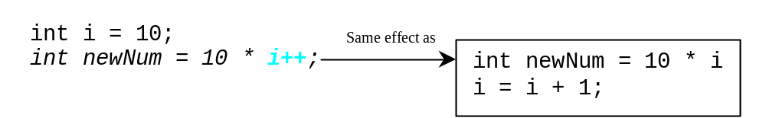
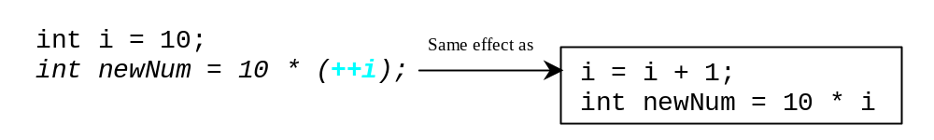
Increment and
Decrement Operators, cont.
Notes:
For the above instance, after the two statements are executed, the variable newNum evaluates to the value 100. But for the below instance, the variable newNum evaluates to the value 110.

Slide 38
Increment and
Decrement Operators, cont.
Using increment and decrement operators makes expressions short, but it also makes them complex and difficult to read. Avoid using these operators in expressions that modify multiple variables, or the same variable for multiple times such as this: int k = ++i + i.

Slide 39
Numeric Type Conversion
Sometimes, it is necessary to mix numeric values of different data types in a computation.
Consider the following statements:
short i = 100;
long k = i * 3 + 4;
double d = i * 3.1 + k / 2;
Notes:
The left part and right part in an expression have two different data types.

Slide 40
Numeric Type Conversion
Numeric type conversion has two types:
automatic conversion on some rules;
manual conversion using a casting operator.

Slide 41
Numeric Type Conversion
C++ automatically converts the operand based on the following rules:
If one of the operands is long double, the other is converted into long double.
If one of the operands is double, the other is converted into double.
If one of the operands is float, the other is converted into float.
If one of the operands is unsigned long, the other is converted into unsigned long.
If one of the operands is long, the other is converted into long.
If one of the operands is unsigned int, the other is converted into unsigned int.
Otherwise, both operands are converted into int.
Notes:
From these rules, we can get the conclusion that the direction of automatic conversion is more precise data type.

Slide 42
Type Casting
Implicit casting
double d = 3; (type widening)
Explicit casting
int i = static_cast<int>(3.0); (type narrowing)
int i = (int)3.9;
(Fraction part is truncated)

Slide 43
NOTE
Casting does not change the variable being cast. For example, d is not changed after casting in the following code:
double d = 4.5;
int i = static_cast<int>(d); // d is not changed

Slide 44
Example: Keeping Two Digits After Decimal Points
Write a program that displays the sales tax with two digits after the decimal point. We can use setiosflags(ios::fixed) and setprecision(3) functions to set the number of digits after the decimal point.
#include <iostream>
using namespace std;
int main()
{
double purchaseAmount;
cout<<"Enter purchase amount:";
cin>>purchaseAmount;
double tax=purchaseAmount*0.06;
cout<<"Sales tax is "<<
static_cast<int>(tax*100)/100.0<<endl;
return 0;
}
SalesTax
Notes:
The function of keeping two digits after decimal points is implemented by the operator static_cast. Let’s see an example. (1.567*100)/100.0

Slide 45
Character Data Type
The character type, char, is used to represent a single character. A character literal is enclosed in single quotation marks.
char letter = 'A'; (ASCII)
char numChar = '4'; (ASCII)
NOTE: The increment and decrement operators can also be used on char variables to get the next or preceding character. For example, the following statements display character b.
char ch = 'a';
cout << ++ch;
Notes:
For ++ch, we should notice two things. One is the original data type, char, is automatically converted into int. And the other thing is the expression evaluates to the new value after the variable, ch, is incremented by 1.

Slide 46
Read Characters
To read a character from the keyboard, use cin object as follows:
  cout << "Enter a character: ";
  char ch;
  cin >> ch;

Slide 47
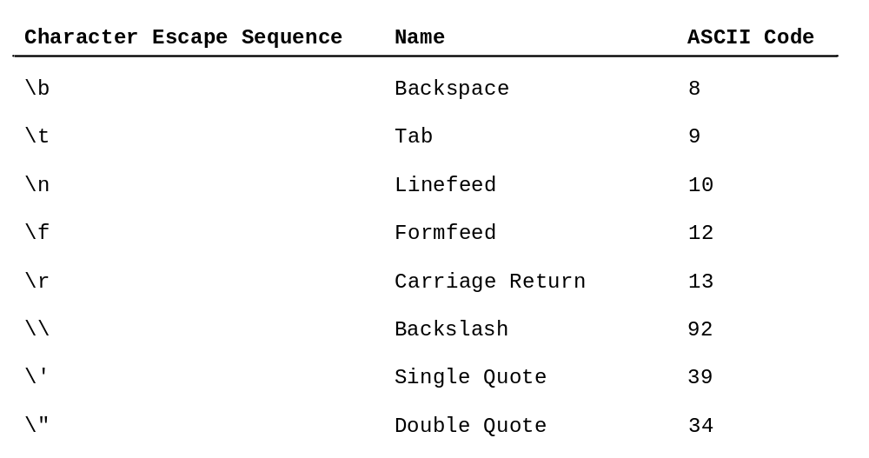
Escape Sequences for Special Characters
Notes:
Especially, single quotation marks and double quotation marks have special functions. Single quotation marks are used to enclose character literal and double quotation marks are used to enclose string literal. So, if we want to display single quotation marks or double quotation marks, we must use the escape sequences.

Slide 48

Appendix B: ASCII Character Set
ASCII Character Set is a subset of the Unicode from \u0000 to \u007f
Notes:
The decimal index for 0 is 48. The decimal index for lowercase letter a is 97. The decimal index for uppercase letter A is 65. And for the same two letters with lowercase and uppercase form, the difference between the decimal indexes is 32.
The decimal index for uppercase A is 65 and the decimal index for lowercase a is 97.
The difference between the uppe

Slide 49
Appendix B: ASCII Character Set
The decimal index for uppercase A is 65 and the decimal index for lowercase a is 97.
The difference between the uppercase and the lowercase form for the same character is 32 (decimal form) or 20H (hexadecimal form).
The decimal index for o (number 0 not character o) is 48 (decimal form) or 30H (hexadecimal form).
Number 0 is stored in complement code and its value is 0. But the character 0 is stored in ASCII code and its value is 48D.
Notes:
Original code, reverse code and complement code

Slide 50

ASCII Character Set, cont.
ASCII Character Set is a subset of the Unicode from \u0000 to \u007f

Slide 51
Casting between char and Numeric Types
A char can be cast into any numeric type, and vice versa. When an integer is cast into a char, only its lower 8 bits of data are used.
int i = 'a'; // Same as int i = (int)'a';
char c = 97; // Same as char c = (char)97;

Slide 52
Numeric Operators on Characters
The char type is treated as if it is an integer of the byte size. All numeric operators can be applied to char operands. A char operand is automatically cast into a number if the other operand is a number or a character. For example, the following statements
int i = '2' + '3'; // (int)'2' is 50 and (int)'3' is 51
cout << "i is " << i << endl; // i is decimal 101
int j = 2 + 'a'; // (int)'a' is 97
cout << "j is " << j << endl;
cout << j << " is the ASCII code for character " <<
static_cast<char>(j) << endl;
Display
i is 101
j is 99
99 is the ASCII code for character c

Slide 53
Note
It is worthwhile to note that the ASCII for lowercase letters are consecutive integers starting from the code for 'a', then for 'b', 'c', ..., and 'z'. The same is true for the uppercase letters. Furthermore, the ASCII code for 'a' is greater than the code for 'A'. So 'a' - 'A' is the same as 'b' - 'B'. For a lowercase letter ch, its corresponding uppercase letter is static_cast<char>('A' + (ch - 'a')).

Slide 54
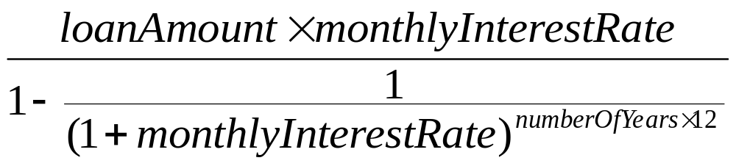
Example:
Computing Loan Payments
This program lets the user enter the interest rate, number of years, and loan amount and computes monthly payment and total payment.
ComputeLoan

Slide 55
Example:
Computing Loan Payments
#include <iostream>
#include <cmath>
using namespace std;
int main()
{
cout<<"Enter yearly interest rate, for example 8.25: ";
double annualInterestRate;
cin>>annualInterestRate;
double monthlyInterestRate=annualInterestRate/1200;
cout<<"Enter the number of years as an integer, for example 5:";
int numberOfYears;
cin>>numberOfYears;
cout<<"Enter loan amount, for example 120000.95: ";
double loanAmount;
cin>>loanAmount;
double monthlyPayment=loanAmount*monthlyInterestRate/
(1-1/pow(1+monthlyInterestRate,numberOfYears*12));
double totalPayment=monthlyPayment*12*numberOfYears;
monthlyPayment=static_cast<int>(monthlyPayment*100)/100.0;
totalPayment=static_cast<int>(totalPayment*100)/100.0;
cout<<"The monthly payment is "<<monthlyPayment
<<"\nThe total payment is "<<totalPayment<<endl;
return 0;
}

Slide 56
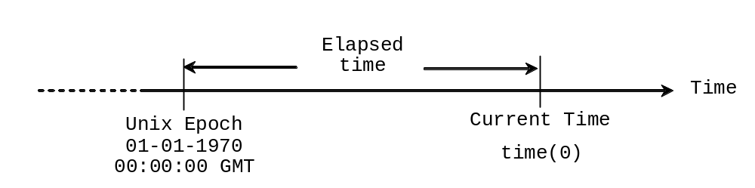
Example: Displaying Current Time
Write a program that displays current time in GMT in the format hour:minute:second such as 1:45:19.
The time(0) function in the ctime header file returns the current time in seconds elapsed since the time 00:00:00 on January 1, 1970 GMT, as shown in Figure 2.1. This time is known as the Unix epoch because 1970 was the year when the Unix operating system was formally introduced.
ShowCurrentTime

Slide 57
Example: Displaying Current Time
#include <iostream>
#include <ctime>
using namespace std;
int main()
{
int totalSeconds = time(0);
int currentSecond = totalSeconds%60;
int totalMinutes = totalSeconds/60;
int currentMinute = totalMinutes%60;
long totalHours = totalMinutes/60;
int currentHour = (int)(totalHours%24);
cout<<"Current time is: "
<<currentHour<<":"
<<currentMinute<<":"
<<currentSecond<<endl;
return 0;
}

Slide 58
Programming Errors
syntax errors
runtime errors
logic errors

Slide 59
Programming Errors
Errors that occur during compilation are called syntax errors or compilation errors. Syntax errors result from errors in code construction, such as mistyping a keyword, omitting some necessary punctuation, or using an opening brace without a corresponding closing brace.

Slide 60
Programming Errors
Runtime errors are errors that cause a program to terminate abnormally. Runtime errors occur while an application is running if the environment detects an operation that is impossible to carry out. For example, the statement “3/0;” may cause a runtime error.

Slide 61
Programming Errors
Logic errors occur when a program does not perform the way it was tended to. For example, if we use this expression to convert from farenheit to celsius degree, there is a logic error.
double celsius = (5/9)*(farenheit-32);

Slide 62
Programming Style and Documentation
Appropriate Comments
Naming Conventions
Proper Indentation and Spacing Lines
Block Styles

Slide 63
Chapter Summary
C++ provides integer types that represent signed and unsigned integers of various sizes and floating-point types that represent floating-point numbers of various precisions. Character type represents a single character. These are called primitive types. When a variable is declared, it is assigned memory spaces. The actual sizes of these types are dependent on the compiler.

Slide 64
Chapter Summary
C++ provides operators that perform numeric operators: addition, subtraction, multiplication, division and modulus. Integer division yields an integer result. The modulus operator yields the remainder of the division.

Slide 65
Chapter Summary
The increment operator ++ and the decrement operator – increment or decrement a variable by 1. If the operator is prefixed to the variable, the variable is first incremented or decremented by 1, then used in the expression. If the operator is suffixed to the variable, the variable is incremented or decremented by 1, but then the original old value is used in the expression.

Slide 66
Chapter Summary
All the numeric operators can be applied to characters. When an operand is a character, the character’s code value is used in the operation.

Slide 67
Chapter Summary
You can using casting to convert a value of one type into another type. Casting a variable of a type with a small range to a variable of a type with a larger range is knowing as widening a type. Casting a variable of a type with a large range to a variable of a type with a smaller range is known as narrowing a type. Narrowing a type may lose precision.

Slide 68
Chapter Summary
Programming errors can be categorized into three types: syntax errors, runtime errors and logic errors. Errors that occur during compilation are called syntax errors or compilation errors. Runtime errors are errors that cause a program to terminate abnormally. Logic errors occur when a program does not perform the way it was tended to.

